Slide 1

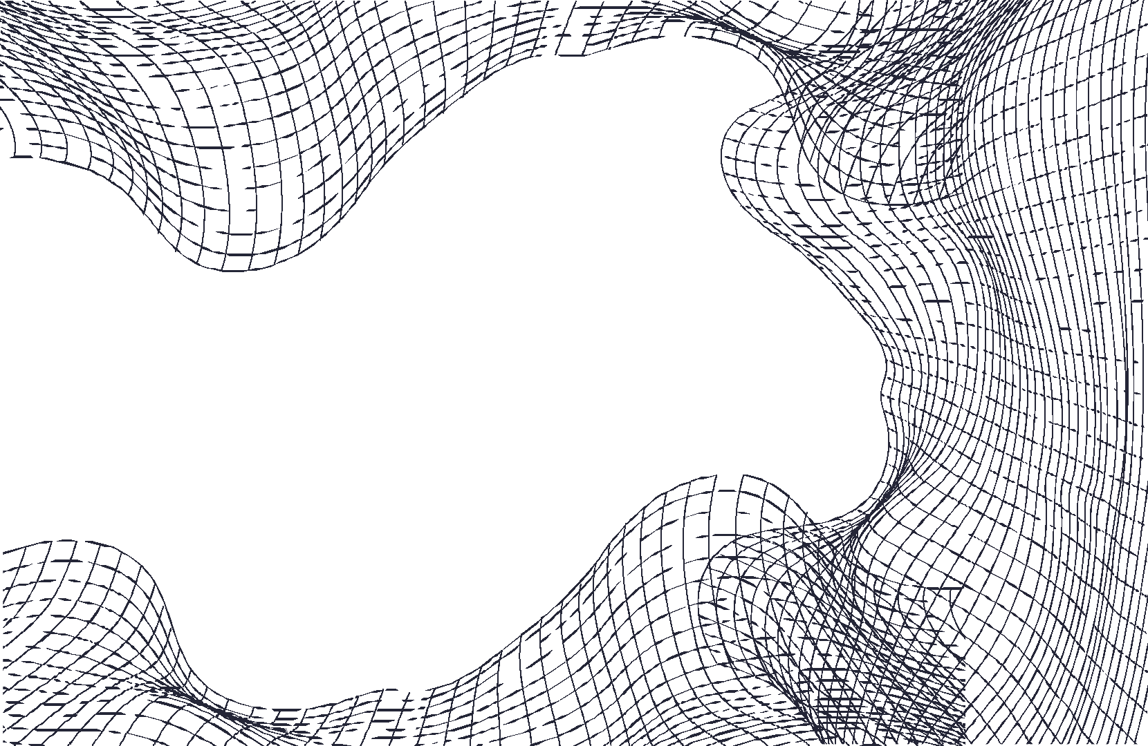
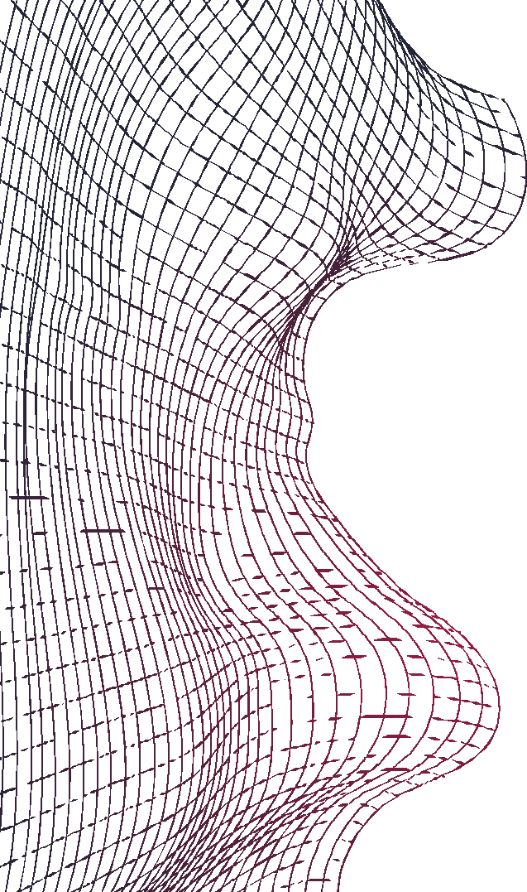
Real or Not? Natural Language Processing with Disaster Tweets
NISHANTH D KINI
NITTE MEENAKSHI INSTITUTE OF TECHNOLOGY

Slide 2

TABLE OF CONTENTS
01
PROBLEM & GOAL OF PROJECT
Problem to be solved and goal of project
02
SOLUTION: Overview of System Architecture
High level overview of proposed solution
03
SOLUTION : In Depth Look
In depth look at the machine learning approach
04
RESULTS : Model Performance & Evaluation
Model selection, performance metrics, results on example tweets
05 PROJECT LIMITATIONS & SUMMARY
High level takeaways
06
SYSTEM DEMO
Demo of system version A & version D

Slide 3

01 PROBLEM & GOAL OF PROJECT
Problem statement is that with the enormity of tweets being sent on Twitter at any point in time, it is hard manually decipher which tweet is about an emergency situation.
Because of this, more agencies are interested in programmatically monitoring social media platforms in order to inform stakeholders and take steps towards emergency situation relief.
Agencies such as disaster relief organizations and news agencies are interested to identify emergencies as soon as possible by monitoring social media
Thus, the users of the system would be disaster relief organizations, news agencies, ﬁrst responders such as paramedics, ﬁreﬁghters and police personnel
Goal of this project to analyze tweets to predict which tweets are about real disasters
and which ones are not.
This project is framed as a binary classiﬁcation supervised machine learning and natural language processing task.

Slide 4
02 SOLUTION : Overview of System Architecture
System architecture:
Two versions of the system were created - Version A and Version D.
While both versions differ when it comes to the speciﬁcs, the underlying structure is the same:
Data Cleaning & Feature Engineering
Machine Learning Models
Hyperparameter Tuning
Model Performance
& Evaluation
Figure A: Underlying Structure and Flow of Both Versions

Slide 5
03 SOLUTION : In Depth Look
Version A
Version D
Data Cleaning & Feature Engineering:
Data cleaning & Feature Engineering:
Removed URLs, emojis, html tags, numbers, punctuation, stop words
Lemmatization
Combine two columns, ‘keyword’ and ‘tweet text’ into one column
GoogleNews-vectors-negative300 for word vectorization
Removed URLs, emojis, html tags, punctuation, stop words
Stemming
Just used ‘tweet text’ column
Used countVectorizer for bag of words
Machine Learning Models Used:
Logistic Regression
Decision Tree Classiﬁer
Gradient Boosting Model
K Nearest Neighbors (K-nn)
Support Vector Machine (SVM)
Machine Learning Models Used:
Adaboost
Ridge
K Nearest Neighbors (K-nn)
Support Vector Machine (SVM) with linear kernel
Hyperparameter tuning:
Hyperparameter tuning:
Using model selection’s Gridsearch Cross Validation
Manual tuning

Slide 6
04 RESULTS : Model Performance & Evaluation
 |  | Model | Test Accuracy | Test F1 Score
Version A |  | Adaboost | 0.74 | 0.69
 |  | Ridge | 0.78 | 0.72
 |  | K-nn | 0.77 | 0.71
 |  | SVM with linear kernel | 0.77 | 0.72
Version D |  | Logistic Regression | 0.78 | 0.71
 |  | Decision Tree Classifier | 0.74 | 0.67
 |  | Gradient Boosting Model | 0.74 | 0.59
 |  | K-nn | 0.72 | 0.57
 |  | SVM | 0.61 | 0.12
Best Models

Slide 7
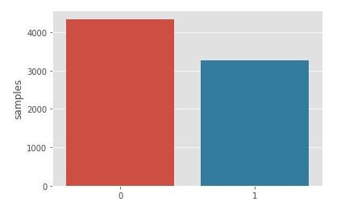
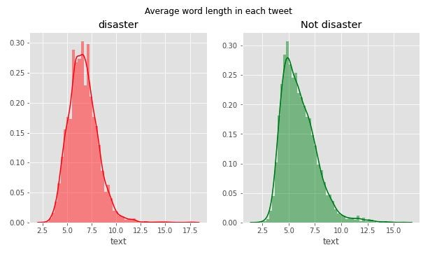
05 PROJECT LIMITATIONS & SUMMARY
Limitations:
Generalizability:
Since the dataset is relatively small (7613 tweets) and the data set was curated, the performance of models in either versions on real world data set may not lead to as high performance results.
Balance of Datasets:
This kaggle dataset was almost balanced among tweets that were about a disaster and those that were not. The proportion in real world data sets is likely to differ (ﬁgure B).
Figure B: Dataset is roughly balanced
Variability within tweets:
It is likely that tweets in real world data sets have more variability than those in this kaggle dataset (ﬁgure C, D).
Computing Resources:
Our laptops didn’t have enough computation power to run more sophisticated models such as Google Bert. More sophisticated models may have a better performance but at the cost of interpretability.
Figure C: Variability within tweets - roughly same avg word length

Slide 8
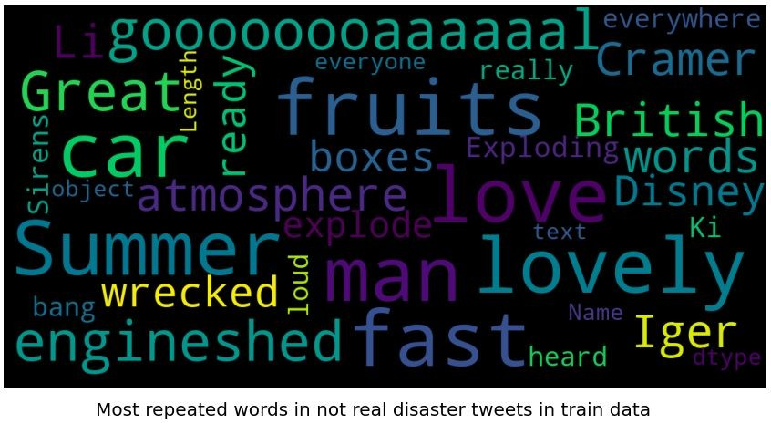
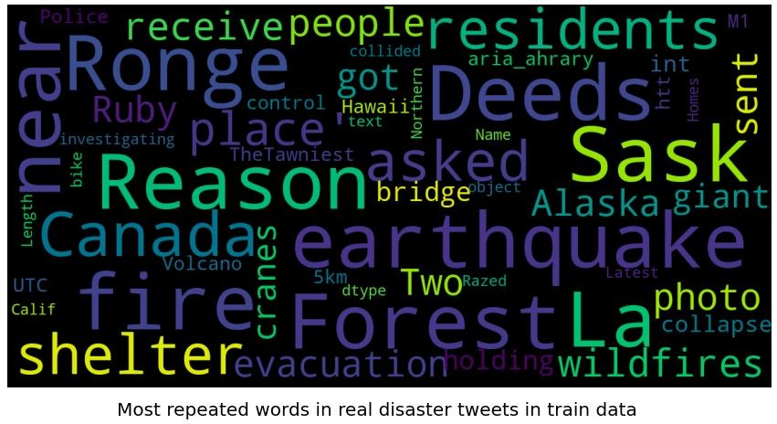
05 PROJECT LIMITATIONS & SUMMARY
Limitations:
Generalizability:
Since the dataset is relatively small (7613 tweets) and the data set was curated, the performance of models in either versions on real world data set may not lead to as high performance results.
Balance of Datasets:
This kaggle dataset was almost balanced among tweets that were about a disaster and those that were not. The proportion in real world data sets is likely to differ (ﬁgure B).
Figure D: Frequency of words in tweets NOT about a real disaster.
Variability within tweets:
It is likely that tweets in real world data sets have more variability than those in this kaggle dataset (ﬁgure C, D).
Computing Resources:
Our laptops didn’t have enough computation power to run more sophisticated models such as Google Bert. More sophisticated models may have a better performance but at the cost of interpretability.
Figure D: Frequency of words in tweets about a real disaster.

Slide 9
05 PROJECT LIMITATIONS & SUMMARY
Summary:
Our project was based on a kaggle competition using curated twitter data.
The problem statement is that with the enormity of tweets being sent at any point in time, it is hard manually decipher which tweet is about an emergency situation.
Goal of this project to analyze tweets to predict which tweets are about real disasters
and which ones are not.
This project is framed as a binary classiﬁcation supervised machine learning and natural language processing task.

Slide 10
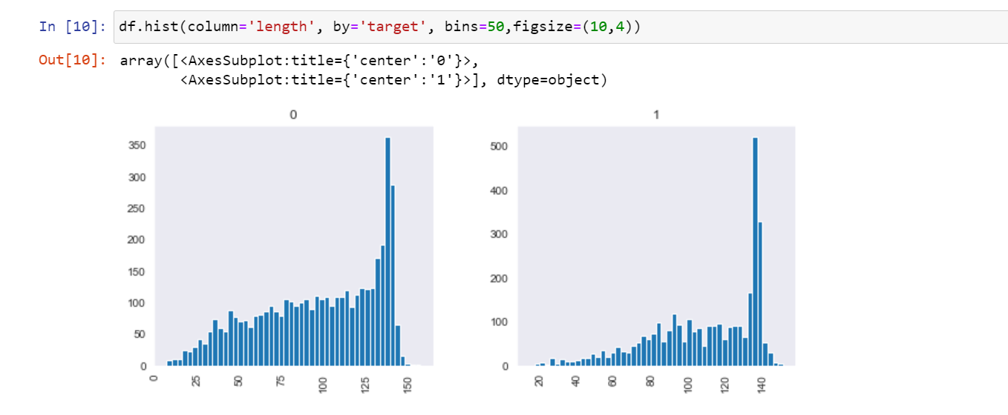

Slide 11
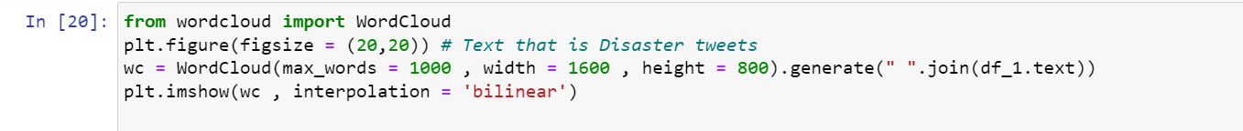
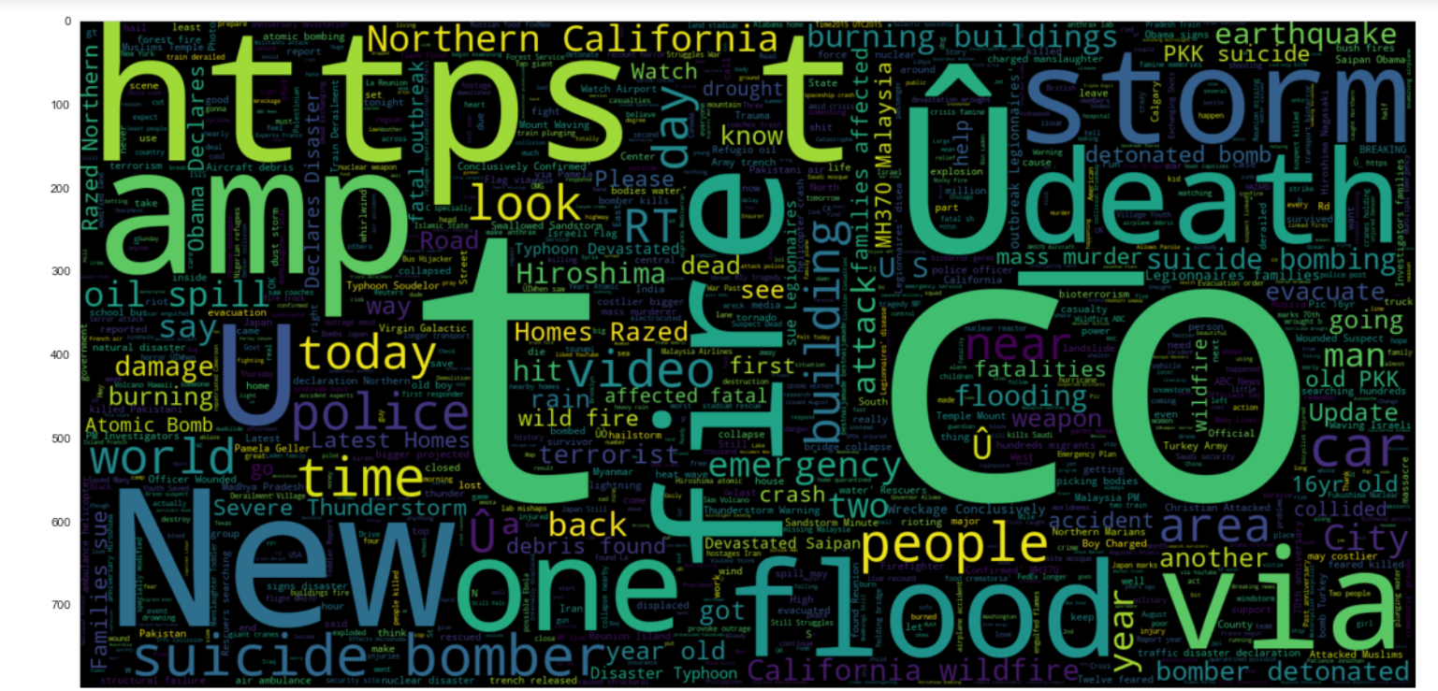

Slide 12
